Slide 1
Unit-V SEQUENTIAL LOGIC DESIGN
Digital Ic Applications
Sk. Enaul Haq
Associate Professor,
Department of ECE,
VVIT

Slide 2
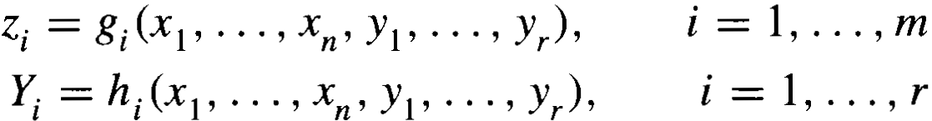
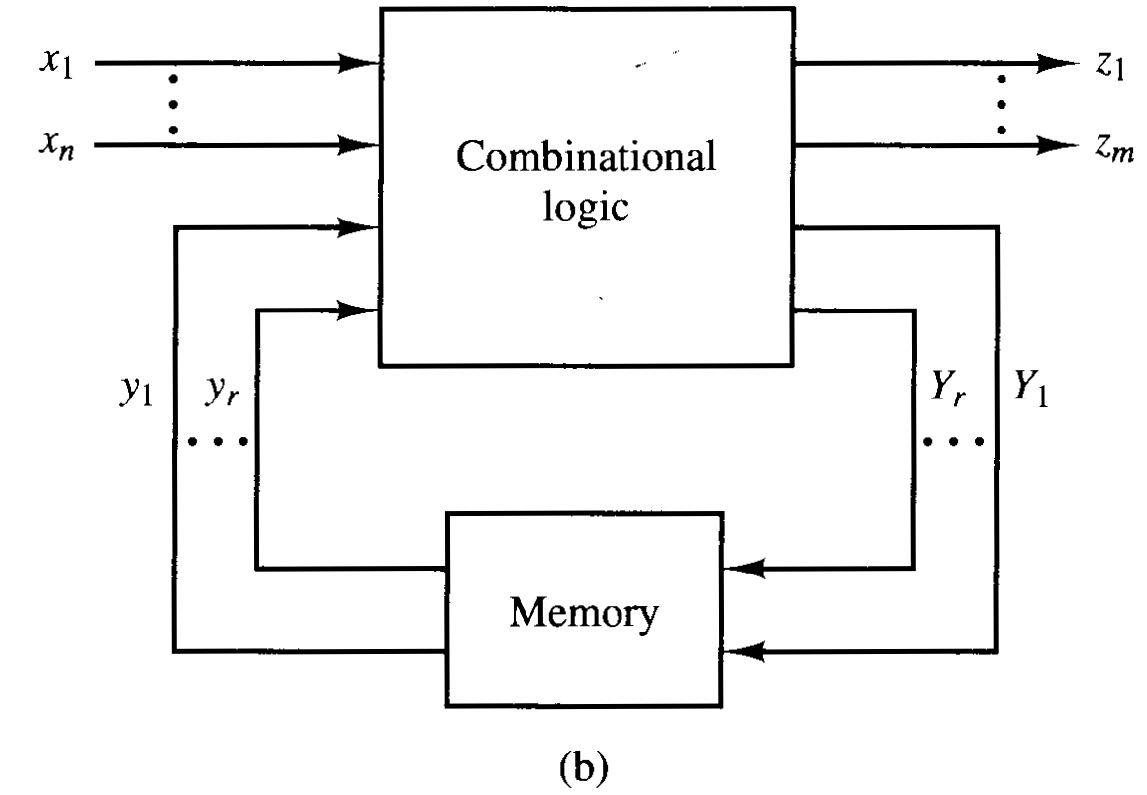
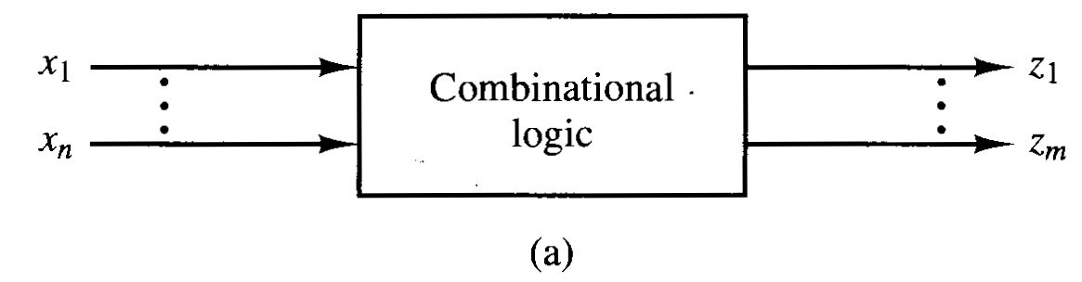
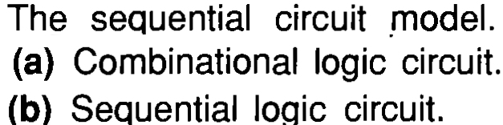
Sequential Circuits
In the combinational logic, output depends upon the present input
The mathematical relationship that describes the circuit is
In the sequential circuits, n-tuples (x1, …..,xn) will be referred to as the input, the m-tuples (z1,…..,zm) will be called the output. And the r-tuples (y1,….,yr) and(Y1, …., Yr) represents present and next state, respectively

Slide 3
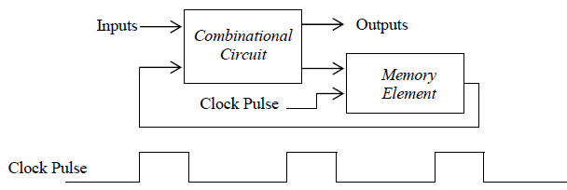
Sequential Circuits
Sequential circuits can be categorized as being synchronous or asynchronous.
A synchronous sequential circuit usually has a clock pulse (clocked sequential circuits).
Flip-flops are storage elements which are used in clocked sequential circuits.
Each flip-flop can store one bit.
A synchronous clocked sequential circuit is shown below:

Slide 4
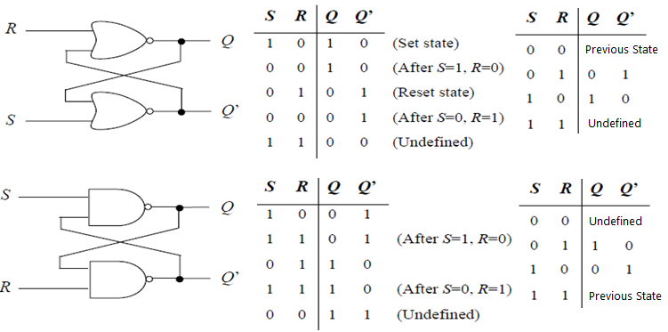
Latches
Latches are the basic types of flip-flops.
The SR latch is a latch with two inputs S (set) and R (reset), and an output Q.
Q = 1 (Q’ = 0) represents the set state and Q = 0 (Q’ = 1) represents the reset state.
The SR latch can be implemented by NOR gates or NAND gates.

Slide 5
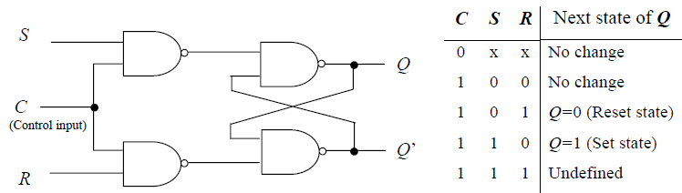
SR Latch with Control (Clock) Input (Clocked SR Latch)
SR Latch can be designed with control (clock) input to synchronize the inputs
Positive or Negative levels of the clock input is considered to trigger the circuit
If the positive edge or negative edge is used to trigger, it is called as flip-flop
Some authors also say that, the circuit without clock input is latch and with clock is flip-flop

Slide 6
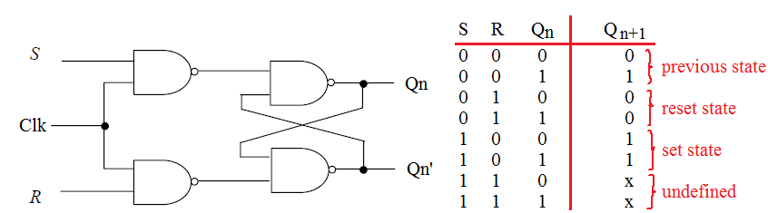
SR Flip-flop
SR flip-flop is a clocked SR latch with edge triggered clock input
Qn is present state and Qn+1 is next state
Characteristic equation of SR flip-flop is

Slide 7
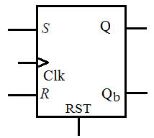
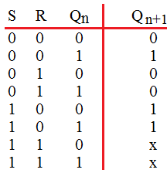
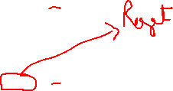
VHDL Code of SR Flip-flop
library IEEE;
use IEEE.STD_LOGIC_1164.ALL;
entity SR_FLIPFLOP is
Port ( S,R,RST,CLK : in STD_LOGIC;
Q,Qb : out STD_LOGIC);
end SR_FLIPFLOP;
architecture Behavioral of SR_FLIPFLOP is
begin
process (S,R,RST,CLK)
begin
if (RST = '1') then
Q <= '0'; Qb <= ‘1’;
elsif (CLK'EVENT and CLK = '1')then
if (S /= R) then
Q <= S; Qb <= R;
elsif (S = '1' and R = '1') then
Q <= ‘X'; Qb <= ‘X';
else Q <= Q; Qb <= Qb;
end if;
end if;
end process;
end Behavioral;
If RST = ‘1’, flip-flop will be reset
It means Q = 0 else it acts as SR
flip-flop

Slide 8
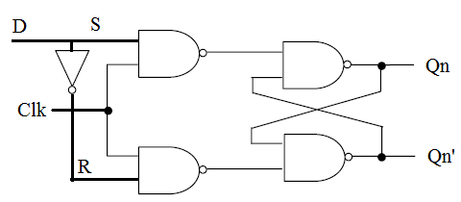
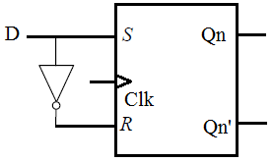
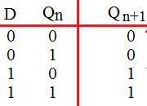



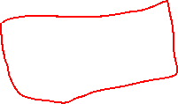


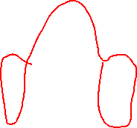
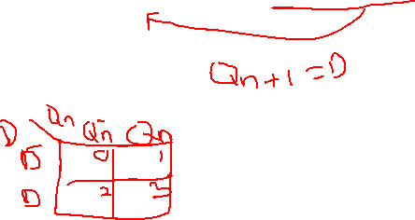
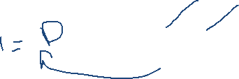
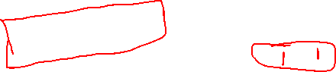
D Flip-flop
D flip-flop is a modified version of SR flip-flop
If the clock input is level-triggered, it is called as clocked D-Latch else it is referred as D flip-flop
Qn is present state and Qn+1 is next state
Characteristic equation of D flip-flop is

Slide 9
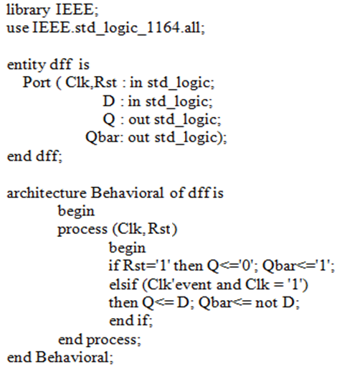
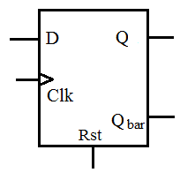
VHDL Code of D Flip-flop
If RST = ‘1’, flip-flop will be reset
It means Q = 0 else it acts as
D flip-flop

Slide 10
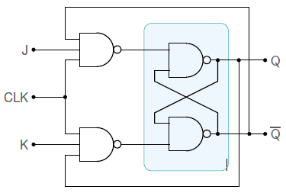
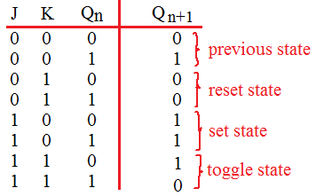
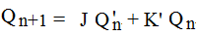
JK Flip-flop
In the JK flip-flop, the output is cross coupled with the inputs as shown below
It avoids the undefined state
Instead, it offers a special state which is called as toggled state wherein the next state is the complement of the present state
Due to this toggling property, it is used to design counters
Qn is present state and Qn+1 is next state
Characteristic equation of SR flip-flop is

Slide 11
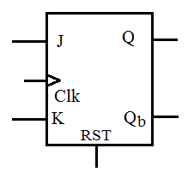
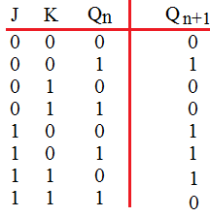
VHDL Code of JK Flip-flop
library IEEE;
use IEEE.STD_LOGIC_1164.ALL;
entity JK_FLIPFLOP is
Port ( J,K,RST,CLK : in STD_LOGIC;
Q,Qb : out STD_LOGIC);
end JK_FLIPFLOP;
architecture Behavioral of JK_FLIPFLOP is
begin
process (J,K,RST,CLK)
begin
if (RST = '1') then
Q <= '0'; Qb <= ‘1’;
elsif (CLK'EVENT and CLK = '1')then
if (J /= K) then
Q <= J; Qb <= K;
elsif (J = '1' and K = '1') then
Q <= not Q; Qb <= not Qb;
else Q <= Q; Qb <= Qb;
end if;
end if;
end process;
end Behavioral;
If RST = ‘1’, flip-flop will be reset
It means Q = 0 else it acts as JK
flip-flop

Slide 12
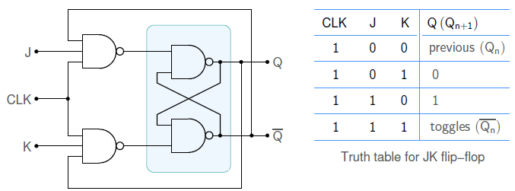
Race-around Condition in JK Flip-flop

Slide 13
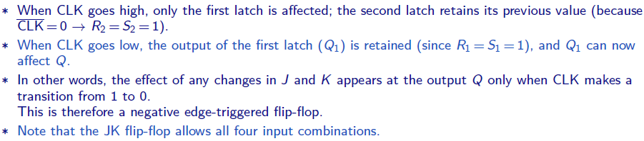
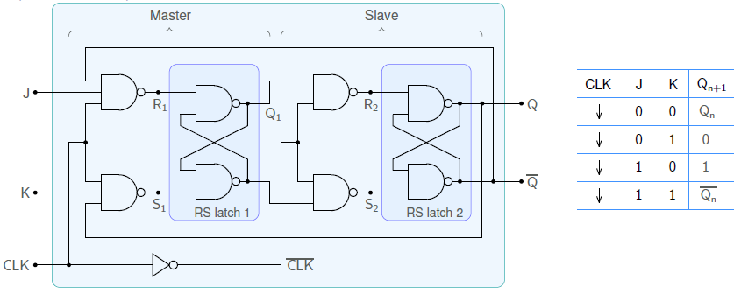
Master-Slave JK Flip-flop

Slide 14
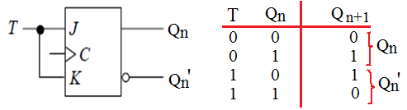
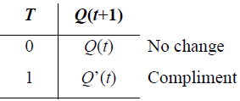
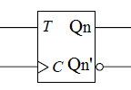
T Flip-flop
T-Flipflop can be derived from the JK flip-flop by shorting the inputs

Slide 15
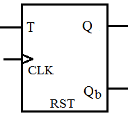
VHDL Code of T Flip-flop
library IEEE;
use IEEE.STD_LOGIC_1164.ALL;
entity T_FLIPFLOP is
Port ( T,RST,CLK : in STD_LOGIC;
Q,Qb : out STD_LOGIC);
end T_FLIPFLOP;
architecture Behavioral of T_FLIPFLOP is
begin
process (T,RST,CLK)
begin
if (RST = '1') then
Q <= '0'; Qb <= ‘1’;
elsif (CLK'EVENT and CLK = '1')then
if (T = ‘0’) then
Q <= Q; Qb <= Qb;
else Q <= not Q; Qb <= Q;
end if;
end if;
end process;
end Behavioral;

Slide 16
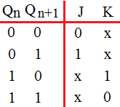
Conversion of Flip-flops
Flip-flops can be converted from one type to another
To do so, we need to know about the excitation of the flip-flop inputs
Excitation tables of the flip-flops can be obtained from the characteristic tables of them
For example, J K Flip-flop
Characteristic Table
Excitation Table

Slide 17
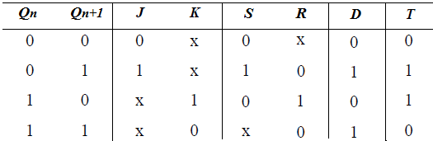
Excitation tables of all Flip-flops
Excitation Table of all the flip-flops

Slide 18
Conversion of Flip-flops
To convert a flip-flop into another, initially we need to take conversion table
Conversion table consists of characterization table of the desired flip-flop, and from the present state and next state derive the excitation inputs of the given flip-flop (use excitation table)
From the conversion table, find out the expressions of the inputs of the given flip-flop

Slide 19
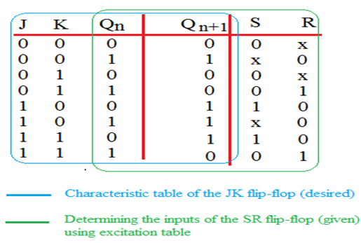
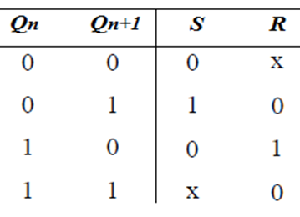
Conversion of Flip-flops
Convert S-R into J-K flip-flop
Desired is J K flip-flop and the given is S R flip-flop
Use 3-variable K-map and obtain the expressions of S and R by considering J, K and Qn as the inputs

Slide 20
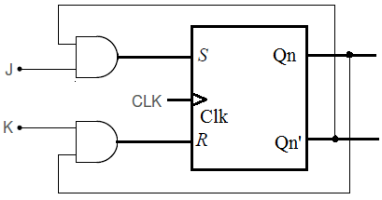






Conversion of Flip-flops
Convert S-R into J-K flip-flop
Use 3-variable K-map and obtain the expressions of S and R by considering J, K and Qn as the inputs
S = J Qn’
R = K Qn

Slide 21
Conversion of Flip-flops
VHDL code of S-R into J-K flip-flop conversion
Write dataflow statements for S and R, also instantiate S R flip-flop
library IEEE;
use IEEE.STD_LOGIC_1164.ALL;
entity SR_FF is
Port ( S,R,CLK : in STD_LOGIC;
Q,Qb : out STD_LOGIC);
end SR_FF;
architecture Behavioral of SR_FF is
begin
process (S,R,CLK)
begin
if (CLK'EVENT and CLK = '1')then
if (S /= R) then
Q <= S; Qb <= R;
elsif (S = '1' and R = '1') then
Q <= ‘X'; Qb <= ‘X';
else Q <= Q; Qb <= Qb;
end if;
end if;
end process;
end Behavioral;
S = J Qn’
R = K Qn
Q
Qb

Slide 22
Conversion of Flip-flops
VHDL code of S-R into J-K flip-flop conversion
library IEEE;
use IEEE.STD_LOGIC_1164.ALL;
entity SR_to_JK is
Port ( J,K,CLK : in STD_LOGIC;
Q,Qb : out STD_LOGIC);
end SR_to_JK;
Architecture STRUC of SR_to_JK is
component SR_FF is
Port ( S,R,CLK : in STD_LOGIC;
Q,Qb : out STD_LOGIC);
end component;
Signal Y1, Y2: std_logic;
Begin
Y1<= J and (not Q);
Y2<= K and Q;
U1: SR_FF portmap (Y1, Y1, CLK, Q, Qb);
end STRUC;
S = J Qn’
R = K Qn
Y1
Q
Y2
Qb

Slide 23
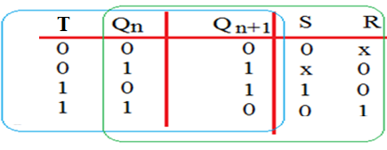
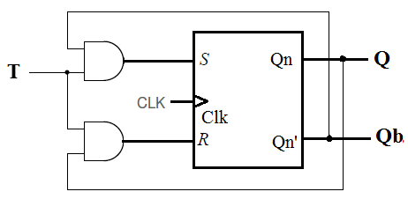
Conversion of Flip-flops
Convert S-R into T-flip-flop
Desired is T flip-flop and the given is S R flip-flop
S = T Qn’
R = T Qn

Slide 24
Conversion of Flip-flops
VHDL code of S-R into T flip-flop conversion
library IEEE;
use IEEE.STD_LOGIC_1164.ALL;
entity SR_to_T is
Port ( T,CLK : in STD_LOGIC;
Q,Qb : out STD_LOGIC);
end SR_to_T;
Architecture STRUC of SR_to_T is
component SR_FF is
Port ( S,R,CLK : in STD_LOGIC;
Q,Qb : out STD_LOGIC);
end component;
Signal Y1, Y2: std_logic;
Begin
Y1<= T and (not Q);
Y2<= T and Q;
U1: SR_FF portmap (Y1, Y1, CLK, Q, Qb);
end STRUC;
S = T Qn’
R = T Qn
Y1
Y2

Slide 25
Conversion of Flip-flops
Output expressions of other expressions
1. JK to T flip-flop conversion
J = T
K = T
2. JK to D flip-flop conversion
J = D
K = D’
3. D to SR flip-flop conversion
D = S+R’Q
4. D to T flip-flop conversion
D = T⊕Q
5. JK to SR flip-flop conversion
J = S
K = R

Slide 26

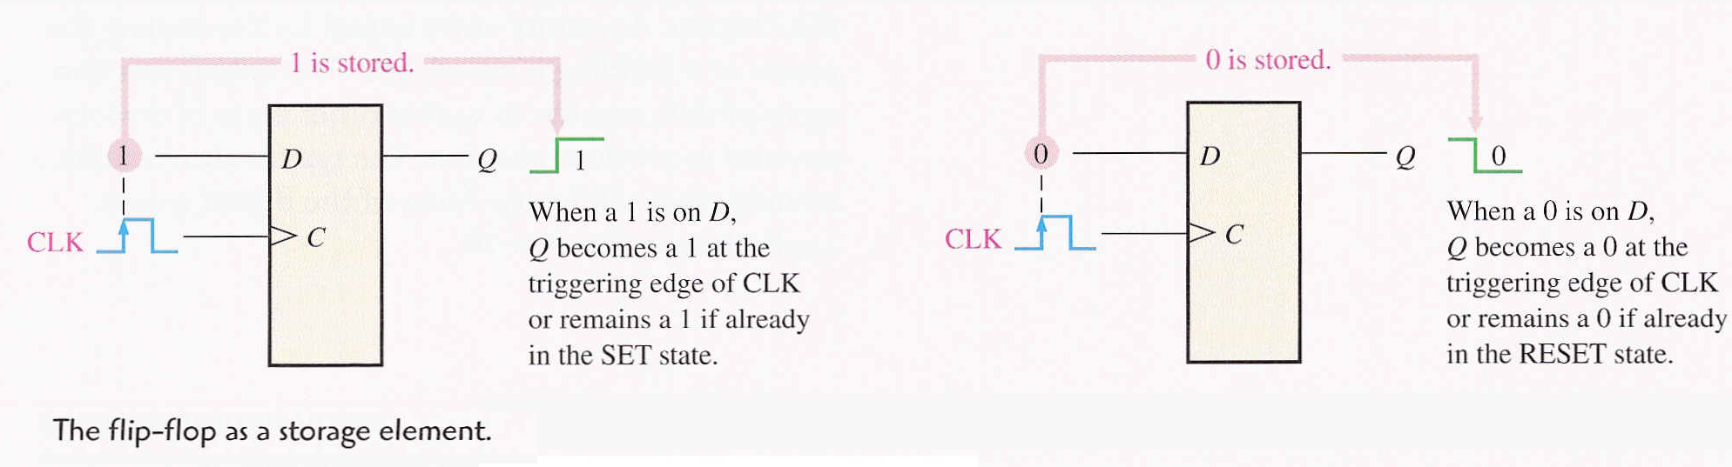
Shift Registers

Slide 27
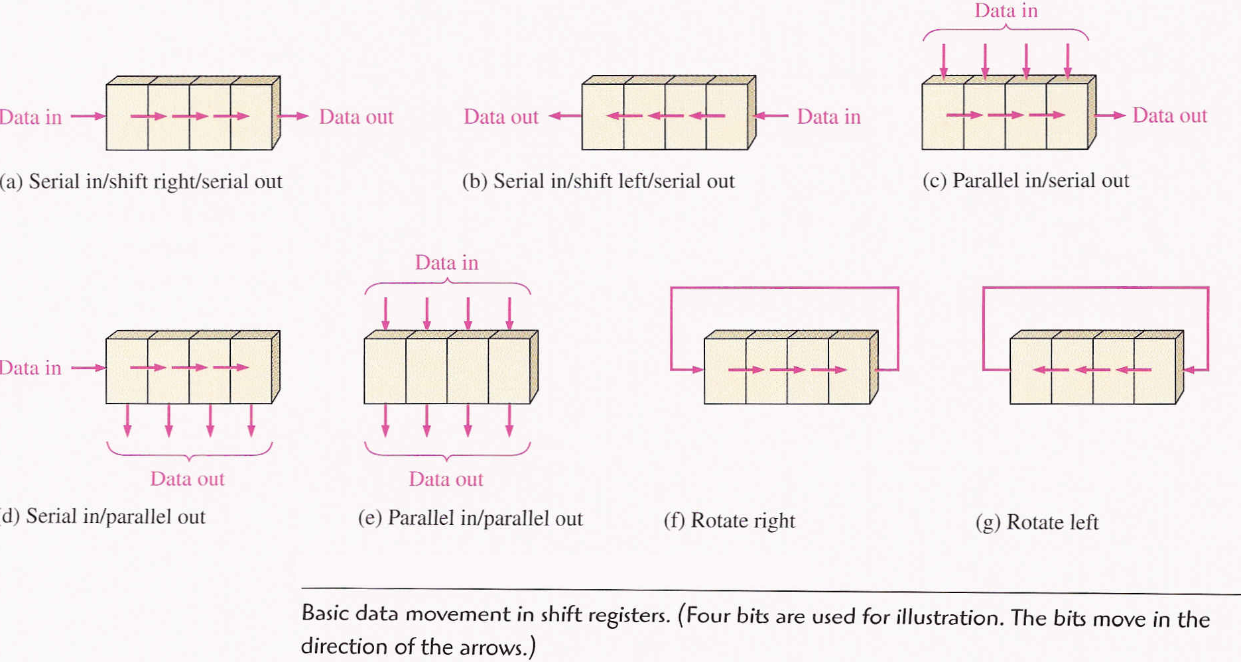
Shift Registers
Basic data movement in shift registers
There are four types of shift registers according to data movement
i. Serial In Serial Out ii. Serial In Parallel Out
iii. Parallel In Serial Out iv. Parallel In Parallel Out

Slide 28
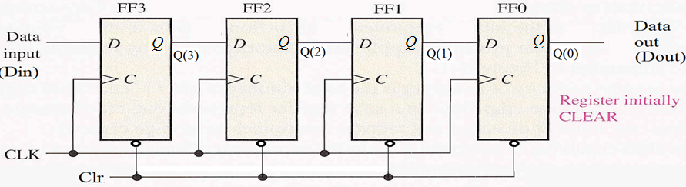
Shift Registers
Serial In Serial Out Shift Register
Basically, D-flip-flops are used to design shift register
Initially, the register is cleared before applying the serial input, then bits are serially applied at “Din”

Slide 29
Shift Registers
VHDL Code of Serial In Serial Out Shift Register
architecture SISO of siso_behavior is begin process (clk,din,reset) is variable Q : std_logic_vector(3 downto 0) := "0000" ; begin if (clr='1') then Q := "0000"; elsif (rising_edge (clk)) then
Q := (din & Q(3 downto 1));
Dout <= Q(0);
end if; end process; end SISO;
library IEEE; use IEEE.STD_LOGIC_1164.all; entity siso_behavior is port(Din : in STD_LOGIC; clk : in STD_LOGIC; clr : in STD_LOGIC; Dout : out STD_LOGIC); end siso_behavior;

Slide 30
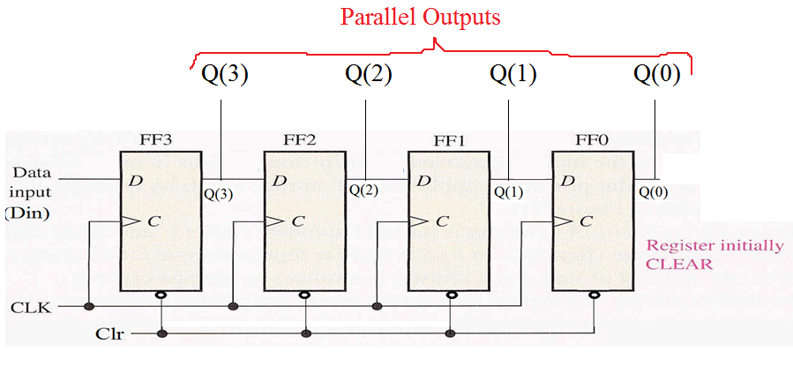
Shift Registers
Serial In Parallel Out Shift Register
Basically, D-flip-flops are used to design shift register
Initially, the register is cleared before applying the serial input, then bits are serially applied at “Din”
Output is collected from the parallel outputs (Q)

Slide 31
Shift Registers
VHDL Code of Serial In Parallel Out Shift Register
architecture SIPO of sipo_behavior is begin process (clk,din,clr) is begin if (clr='1') then Q <= "0000"; elsif (rising_edge (clk)) then
Q(2 downto 0) <= Q(3 downto 1);
Q(3) <= Din;
end if; end process; end SIPO;
library IEEE; use IEEE.STD_LOGIC_1164.all; entity sipo_behavior is port(Din : in STD_LOGIC; clk : in STD_LOGIC; clr : in STD_LOGIC; Q : out STD_LOGIC(3 downto 0)); end sipo_behavior;

Slide 32
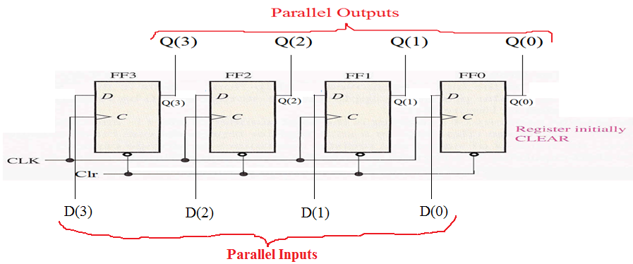
Shift Registers
Parallel In Parallel Out Shift Register
Basically, D-flip-flops are used to design shift register
Initially, the register is cleared before applying the serial input, then bits are serially applied in parallel at input D
Output is collected from the parallel outputs (Q)

Slide 33
Shift Registers
VHDL Code of Parallel In Parallel Out Shift Register
architecture PIPO of pipo_behavior is begin process (clk,din,clr) is begin if (clr='1') then Q <= "0000"; elsif (rising_edge (clk)) then
Q <= D;
end if; end process; end PIPO;
library IEEE; use IEEE.STD_LOGIC_1164.all; entity pipo_behavior is port(D : in std_logic_vector(3 downto 0)); clk : in STD_LOGIC; clr : in STD_LOGIC; Q : out std_logic_vector(3 downto 0)); end pipo_behavior;

Slide 34
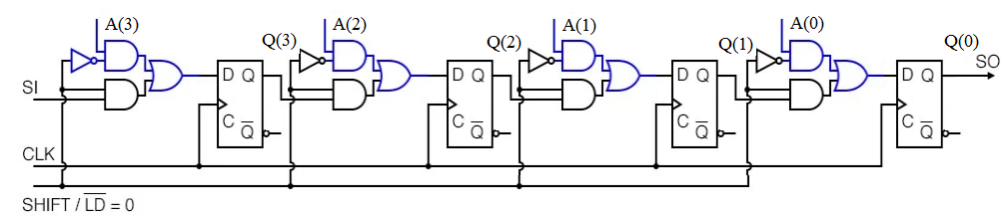
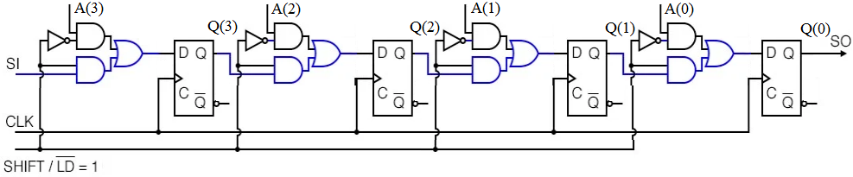
Shift Registers
VHDL Code of Parallel In Serial Out Shift Register
In this PISO register, the input data is loaded in parallel and later it will be shifted
While shifting, the D input of the D-flipflops are to be disconnected with the parallel load inputs
Instead, take serial input and shift it. It can have a value ‘0’ also

Slide 35
Shift Registers
VHDL Code of Parallel In Serial Out Shift Register
architecture PISO of piso_behavior is begin process (clk,A, clr) is variable Q : std_logic_vector(3 downto 0); begin if (clr='1') then Q := "0000"; elsif (rising_edge (clk)) then
if (shift_ld = ‘0’) then Q:= A;
else Q := (SI & Q(3 downto 1));
SO<= Q(0);
end if;
end if; end process; end PISO;
A(3) A(2) A(1) A(0)
SI
CLK
PISO
SO
SHIFT/LD’
library IEEE; use IEEE.STD_LOGIC_1164.all; entity piso_behavior is port(A : in std_logic_vector(3 downto 0)); SI, clk, clr : in STD_LOGIC; clr,shift_ld : in STD_LOGIC; SO : out std_logic; end piso_behavior;

Slide 36
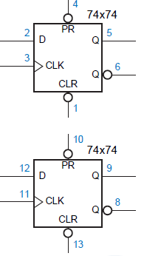
ICs Related to Flip-flops and registers
IC 74X74: Positive edge-triggered D-flip flops
It consists of two D flip-flops with asynchronous preset and clear inputs
PR | CLR | State of the flip-flop
0 | 0 | Invalid (Q = Q’ = 0)
0 | 1 | Q = 1 (set)
1 | 0 | Q = 0 (reset)
1 | 1 | Operational mode

Slide 37
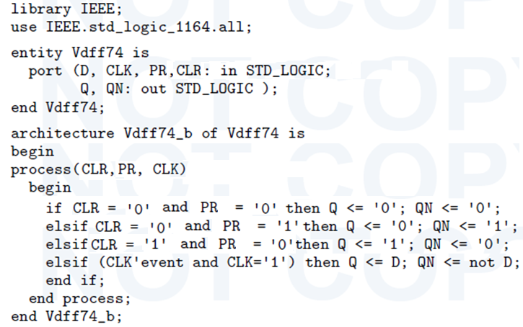
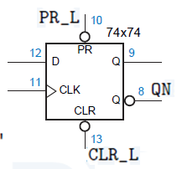
ICs Related to Flip-flops and registers
VHDL Code of IC 74X74: Positive edge-triggered D-flip flops

Slide 38



ICs Related to Flip-flops and registers
IC 74x175- Multi-bit Registers

Slide 39


ICs Related to Flip-flops and registers
Other Multi-bit Register ICs

Slide 40


Universal Shift Register
4-bit Universal Shift Register
A Universal shift register is a register which has both the right shift and left shift with parallel load capabilities. Universal shift registers are used as memory elements in computers. A Unidirectional shift register is capable of shifting in only one direction. A bidirectional shift register is capable of shifting in both the directions.
QA QB QC QD (Present state) & QA* QB* QC* QD* (Next state)
Case 1: S1=S0=0 – No shift
Case 2: Loaded data shifts towards right and the bit at RIN moves to QA*
Case 3: Loaded data shifts towards left and the bit at LIN moves to QD*
Case 4: Parallel loading of data A B C D into QA* QB* QC* QD*

Slide 41



Universal Shift Register
VHDL Code of 4-bit Universal Shift Register
library IEEE; use IEEE.STD_LOGIC_1164.all; entity USR is port(D : in std_logic_vector(3 downto 0);
Q : out std_logic_vector(3 downto 0); S : in std_logic_vector(1 downto 0); Clr, Clk: in STD_LOGIC; RIN, LIN : in std_logic); end USR;
architecture Behav of USR is begin process (D, S, Clk, Clr, RIN, LIN) begin
If (Clr = ‘1’) then Q <= “0000” ;
elsif (Clk’event and Clk = ‘1’) then

Slide 42
Universal Shift Register
VHDL Code of 4-bit Universal Shift Register
Case S is
when “11” =>
Q <= D;
when “10” =>
Q(3 downto 1) <= Q(2 downto 0);
Q(0) <= LIN;
when “01” =>
Q(2 downto 0) <= Q(3 downto 1);
Q(3) <= RIN;
when “00” =>
Q <= Q;
when others =>
null;
end case;
end if;
end process;
end Behav;

Slide 43
Ring Counter
Design of 4-bit Ring Counter
Ring counter is a typical application of Shift resister. Ring counter is almost same as the shift counter.
The only change is that the output of the last flip-flop is connected to the input of the first flip-flop in case of ring counter but in case of shift resister it is taken as output.
To design an n-bit ring counter, we need ‘n’ no. of D flip-flops
There are two types of ring counters
i. Straight ring counter (basic ring counter), and
ii. Twisted ring counter (Johnson counter)
As the clock input is applied commonly to all the flip-flops, ring counter is also called as Synchronous counter

Slide 44



Ring Counter
4-bit Straight Ring Counter (or ring counter)
Ring counter is a shift register wherein output Q3 is feedback to input D0
State of any one of the flip-flop is to be set using “preset (PR)” input and the states of all the remaining are to be cleared using “Clear (CLR)” input
Working
Here, RST is connected to Preset (PR) in FF-0 and it is connected to Clear (CLR) in FF-1, FF-2, and FF-3. Thus, when RST = 0 output Q = 1 is generated at FF-0 and rest of the flip-flop generate output Q = 0.
Later, RST = 1 and keep on applying CLK

Slide 45



Ring Counter
VHDL Code of 4-bit Straight Ring Counter (or ring counter)

Slide 46


Johnson Counter
4-bit Johnson Counter
It is also known as switch-tail ring counter, walking ring counter or Johnson counter
It connects the complement of the output of the last shift register to the input of the first register and circulates a stream of ones followed by zeros around the ring.
Working
Here, RST is connected to Clear (CLR) in FF-0, FF-1, FF-2, and FF-3. Thus, when RST = 0 output Q = 0 is generated for all the flip-flops.
Later, RST = 1 and keep on applying CLK

Slide 47


Johnson Counter
VHDL Code of 4-bit Johnson Counter

Slide 48
Counter
Counters
A Counter is a device which stores (and sometimes displays) the number of times a particular event or process has occurred, often in relationship to a clock signal.
Counters are used in digital electronics for counting purpose, they can count specific event happening in the circuit.
For example, in UP counter a counter increases count for every rising edge of clock.
Counters are broadly divided into two categories
i. Asynchronous counter
ii. Synchronous counter

Slide 49

Counter
Asynchronous Counter
In asynchronous counter we don’t use universal clock, only first flip flop is driven by main clock and the clock input of rest of the following flip flop is driven by output of previous flip flops.
It is evident from timing diagram that Q0 is changing as soon as the rising edge of clock pulse is encountered, Q1 is changing when rising edge of Q0 is encountered(because Q0 is like clock pulse for second flip flop) and so on. In this way ripples are generated through Q0,Q1,Q2,Q3 hence it is also called RIPPLE counter.

Slide 50

Counter
Synchronous Up Counter (4-bit)
Unlike the asynchronous counter, synchronous counter has one global clock which drives each flip flop so output changes in parallel.
The one advantage of synchronous counter over asynchronous counter is, it can operate on higher frequency than asynchronous counter as it does not have cumulative delay because of same clock is given to each flip flop.

Slide 51

Counter
Synchronous Up Counter (4-bit)
From circuit diagram we see that Q0 bit gives response to each falling edge of clock while Q1 is dependent on Q0, Q2 is dependent on Q1 and Q0 , Q3 is dependent on Q2,Q1 and Q0.

Slide 52
















Counter
VHDL Code of Synchronous Up Counter (4-bit)

Slide 53





Counter
Synchronous Down Counter (4-bit)
Unlike the asynchronous counter, synchronous counter has one global clock which drives each flip flop so output changes in parallel.
The one advantage of synchronous counter over asynchronous counter is, it can operate on higher frequency than asynchronous counter as it does not have cumulative delay because of same clock is given to each flip flop.

Slide 54

Counter
VHDL Code of Synchronous Down Counter (4-bit)

Slide 55


Counter
VHDL Code of Synchronous Up/Down Counter (4-bit)

Slide 56

Counter
Decade Counter (Mod-10 Counter)
It produces 10 states ranging from 0000 to 1001
The state 1010 is to be converted into 0000 which is done by using clear input of the counter
A NAND gate is used to apply clear input to the flipflop
Q3 and Q1 are to be applied as inputs of the NAND gate (because the state to be truncated is 1010)

Slide 57


Counter
VHDL Code of Decade Counter (4-bit)

Slide 58
Counter
Design of Synchronous Counter using D-flipflops (or IC 74x74)
Counters can also be designed by using D-flipflops
To design it, state transition table is to be taken, and from it find out the values of input D of each flipflop
Find out the expressions of D inputs of all the flipflops using K-maps
D-flipflops are available in IC 74x74

Slide 59


Counter
Design of Synchronous Counter using D-flipflops (or IC 74x74)

Slide 60


Counter
Design of Synchronous Counter using D-flipflops (or IC 74x74)

Slide 61

Counter
Design of Synchronous Counter using D-flipflops (or IC 74x74)

Slide 62

Counter
VHDL Code of Synchronous Counter using D-flipflops

Slide 63
Counter
Design of ring counter using IC 74x194
IC 74x194 is a Universal Shift Register which can shift data in both the directions
Also it acts as SIPO, PISO,PIPO, and PISO
QA QB QC QD (Present state) & QA* QB* QC* QD* (Next state)
Case 1: S1=S0=0 – No shift
Case 2: Loaded data shifts towards right and the bit at RIN moves to QA*
Case 3: Loaded data shifts towards left and the bit at LIN moves to QD*
Case 4: Parallel loading of data A B C D into QA* QB* QC* QD*

Slide 64


Counter
Design of ring counter using IC 74x194
When RESET = 1, input A B C D will be loaded to QA QB QC QD i.e., 0001
When RESET = 0, Left shift operation happens

Slide 65

Counter
Design of Johnson counter using IC 74x194
When RESET_L = 0, QA QB QC QD become 0000
Upon applying the Clock, Left shift operation happens and the states are 0001, 0011, 0111, 1111, 1110, 1100, 1000, 0000, 0001

